Slide 1
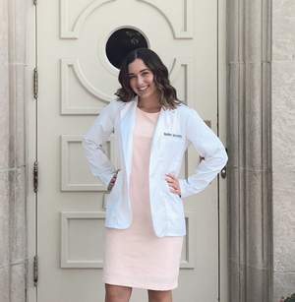
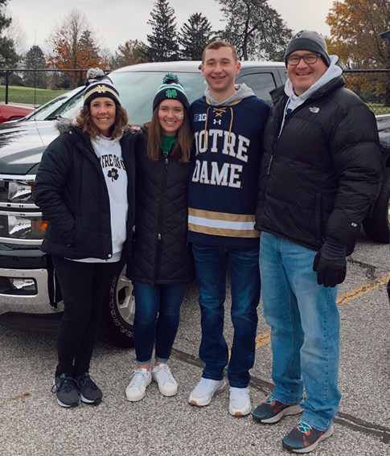
Name: Avery VonDielingen
ATOM Title: Summer Intern 2022
My Experience
Biotechnology course at Butler University which grew my interest for combining Pharmacy with Data Analytics
I am looking forward to expanding my experience in Python and Data Analytics this summer
Education
PharmD Candidate at Butler University Class of 2025
Entrepreneurship concentration
Keywords
Grew up in the Indianapolis, IN area (family has since moved to Wake Forest, NC)
In my free time I enjoy: golfing, walking trails, spending time with friends and family
I also have a twin brother
Email: avondiel@butler.edu

Slide 2
Name: Avery VonDielingen
ATOM Title: Summer Intern 2022
Scientific/Technical Interests
Combining data science with any of the following therapeutic areas:
Diabetic Nephropathy
Rheumatoid Arthritis
Alzheimer’s Disease
Diversity in Clinical Trials
What are your goals for this internship?
To challenge myself through my research and work towards meaningful findings that can be applied to external situations
To collaborate with the ATOM team in order to assist where needed and learn from the team’s knowledge around discussed subjects.
What do you hope to accomplish from this internship?
I hope to become proficient in Python and have a true understanding for how we can improve the drug discovery pipeline through computational analysis and AMPL
I also hope to gain perspective on the impact of data analytics in the pharmacy industry

